Slide 1
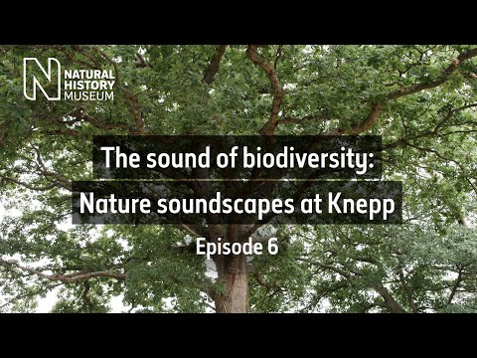
What can you hear? How do the sounds make you feel?
Notes:
https://www.youtube.com/watch?v=ayg-4jJtZf4
At pupils are arriving into the assembly/for the first minute of the assembly- play the video.
Encourage learners to take notice to what they can hear.
End the video with a quick plenary asking learners to think about what they could hear and how the sounds make them feel.
You could ask pupils to share what they heard and how they felt, or you could ask all pupils to indicate if they heard birds, trees moving etc. And share if they felt calm, happy, relaxed etc.
Transition into the intro to the assembly by talking about how nature can make us calm/happy/relaxed etc. and how therefore it is really important that we do our bit to protect nature.

Slide 2
Nature is in trouble- (Insert school name) will help!
The National Education Nature Park
Notes:
National Education Nature Park Primary School Assembly Teacher Guidance.docx
Nature in England is in trouble! The UK has lost a lot of its nature over time and lots of animals and plants that live in our country are struggling. As a school, we are joining a new project that other schools across the whole of England are taking part in to help protect nature. (Insert school name) are going to do our bit to make our school grounds a safe home for living things. Today we are going to talk about what we are going to do! It’s exciting and it will get us out the classroom and into nature! Today you are all explorers and throughout this assembly, you will need to use your skills. Are you ready? Let’s begin our Nature Park journey…

Slide 3
Nature Investigators
Notes:
OPTION A
Insert images from your education setting's grounds for:
A living thing you know the name of/or your pupils would know the name of
A place to sit and relax
A place to play
Show each image on the screen and ask pupils to put their hand up/shout out what they think it is. After they have guessed, you can tell some fun facts about the thing or talk about how nature can be a place to relax and play.

Slide 4
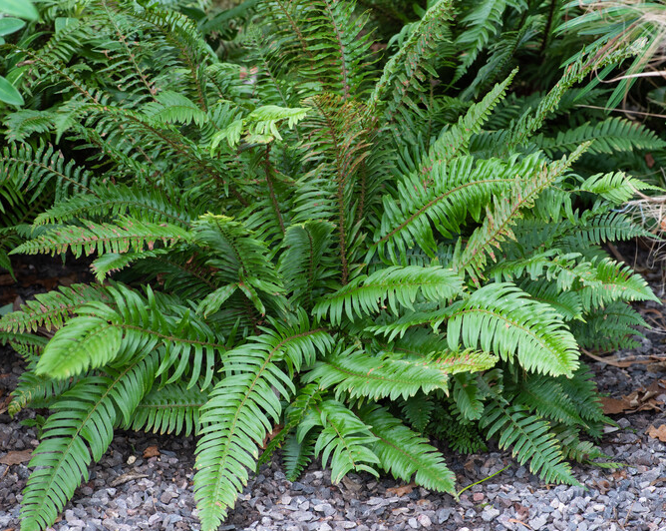
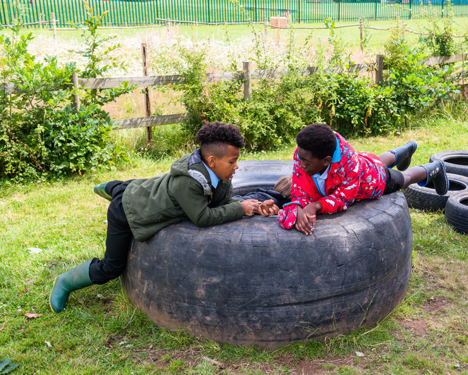
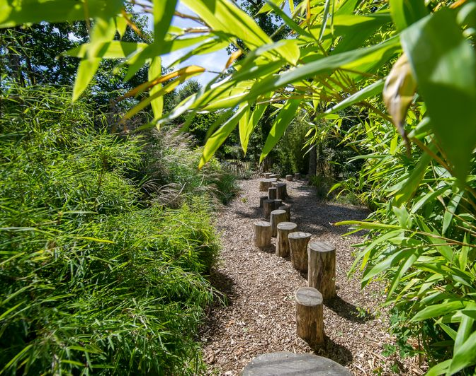
Nature Investigators
Notes:
OPTION B
Plants are living things too, just like animals and insects. Ferns are some of the oldest plants on the Earth and have been around for millions of years, even before dinosaurs were alive! There are over 10,000 different types of ferns! Some ferns can live up to 100 years!
Being outside in nature is the perfect place to sit and relax. Plants can provide shade and a cool place to be when it is really hot and also help to block sounds and make areas quieter. Being surrounded by greenery can help us to feel calm. Did you know that humans can see more shades of green than any other colour? Did you know that humans can see more shades of green than any other colour? There are many different theories to explain this, including one that suggests that being able to detect the colour green helped humans to know what food was safe and ready to eat. No one likes a green banana!
Nature is the perfect playground! We can use grass to play sports, wooded areas to play hide and seek, and climb! We can also have fun exploring, maybe finding mini beasts or being still for a minute and spotting a bird in a tree.

Slide 5
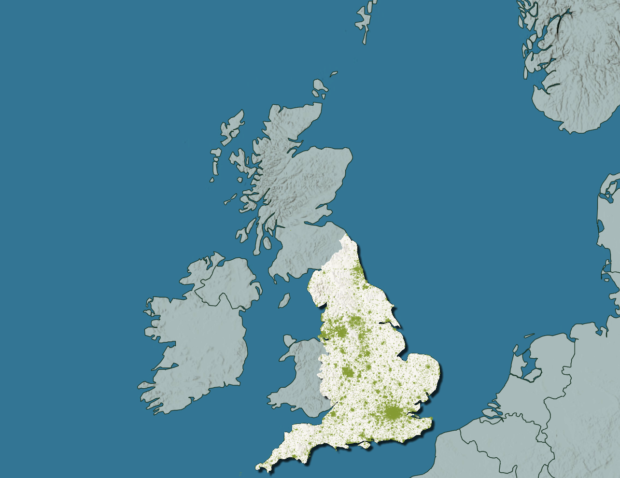
The National Education Nature Park
Notes:
To help make our grounds the best for humans, animals and plants, we are joining the National Education Nature Park, a network of education settings across England who are taking action to protect and improve their space for people, plants, animals and insects.
Our grounds are our nature park. Each school will be working to make their nature park better for people and wildlife and together all of the small changes we make will add up to make a positive difference for nature in England.

Slide 6
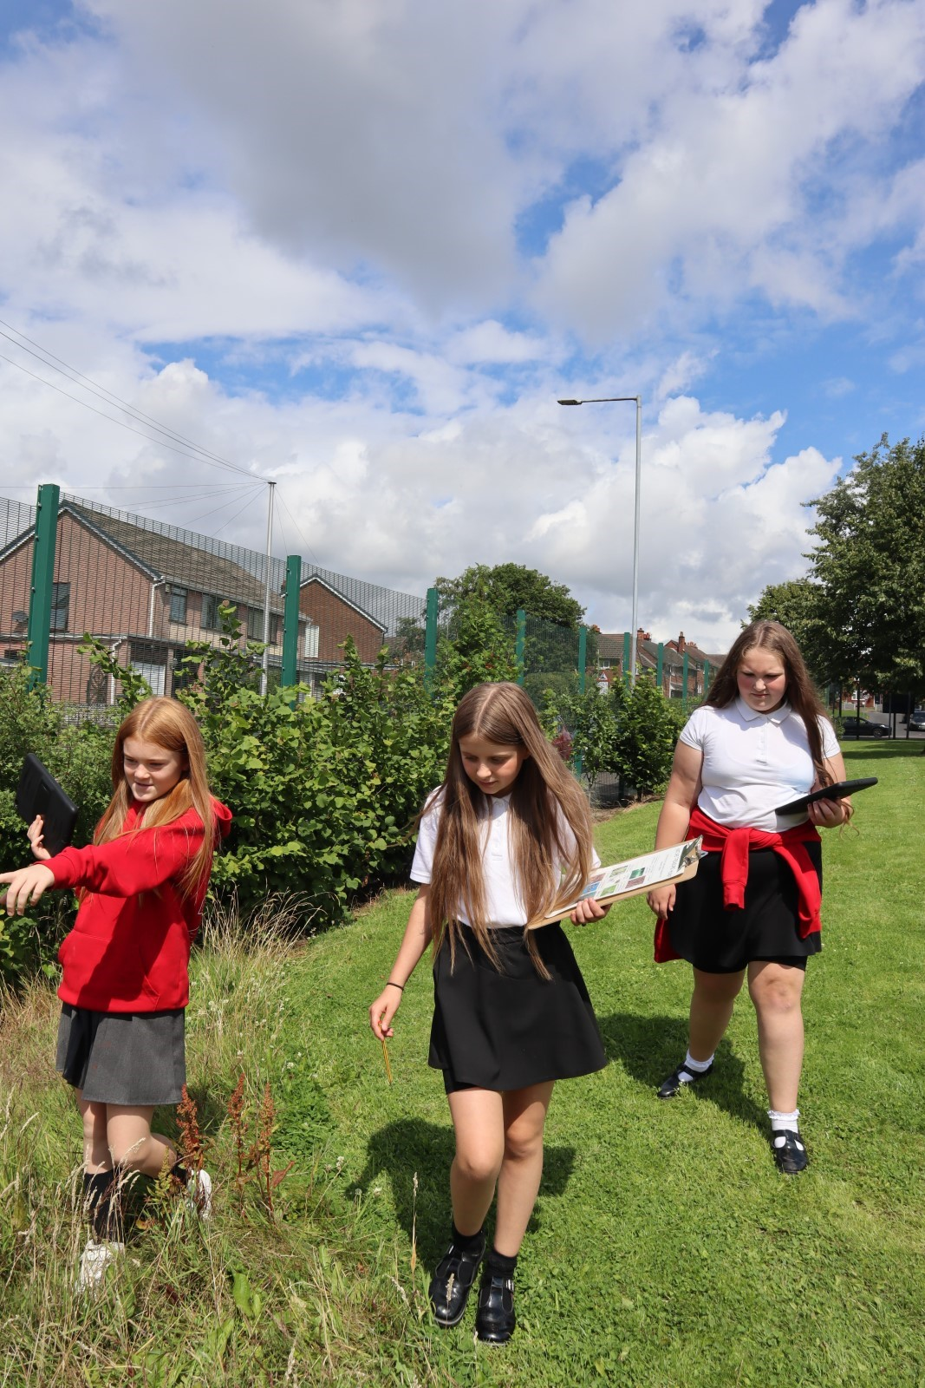
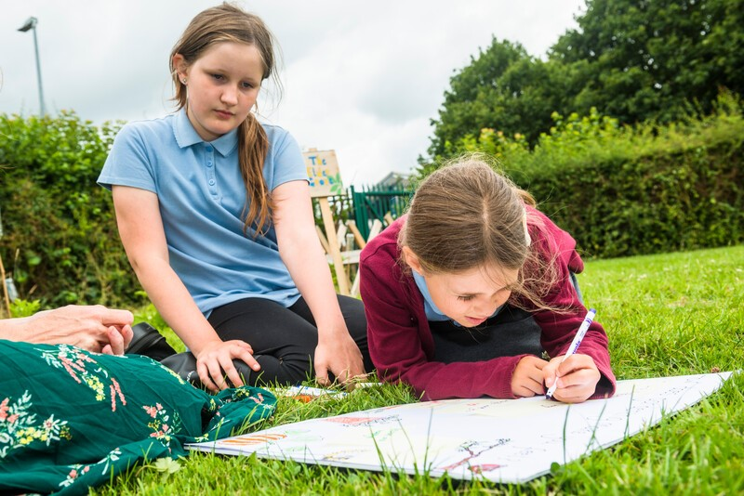
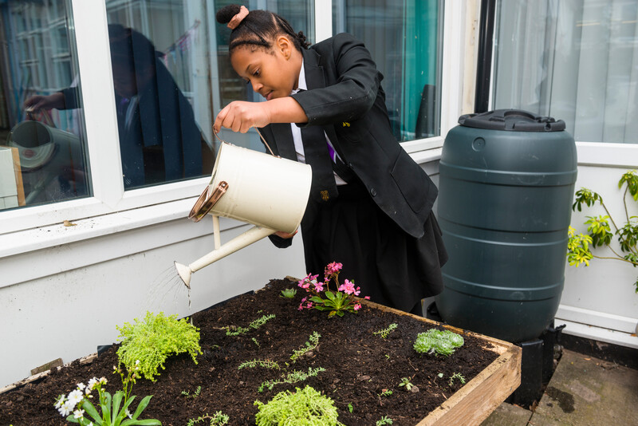
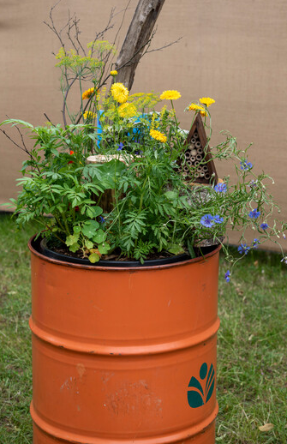
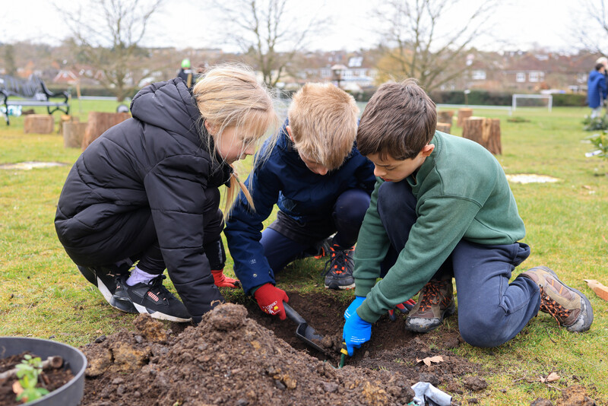
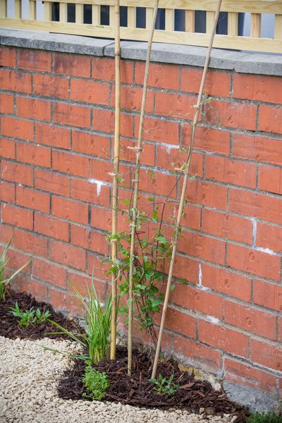
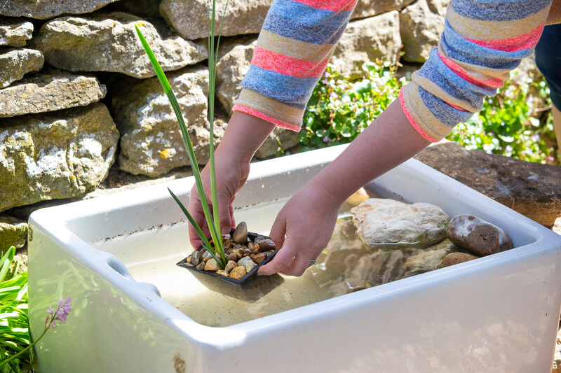
Our Nature Park
Notes:
We will start by getting to know our site by understanding what lives there and how pupils, plants and animals use our site. A bit like what we have done already in this assembly being ‘Nature investigators’!
Then we will create a plan to improve our site for nature.
Examples of what we could do include creating ponds, planting flowers, growing fruit and vegetables, planting trees, creating a green wall and capturing rainwater in water butts (delete anything you have already done. ‘We have already____ and we will continue to make a positive difference by….’).
Then we will keep looking at what is living and growing on our site and investigate the difference we have made for nature.
Our Nature Park will create the most positive impact if everyone at (insert education setting name) gets involved.

Slide 7
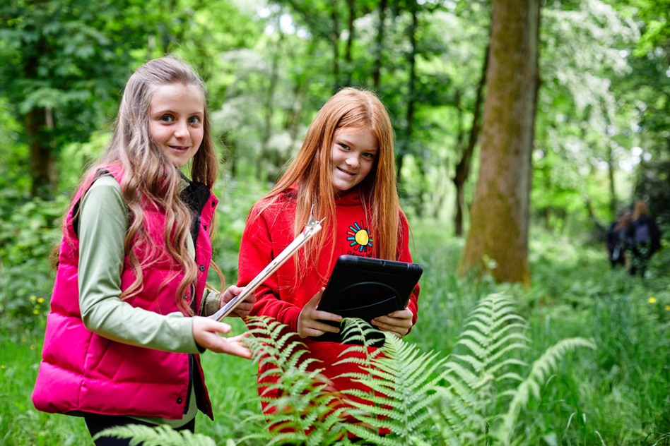
What can we do?
Teachers can help us to develop green and digital skills and understand more about how to look after nature and the planet.
Head teachers can help us to grow and develop our outdoor spaces, thinking about the needs of the school community.
Caretakers can help us to develop and maintain our school grounds so that it caters for the needs of nature and for the community.
Other adults can support learning outside.
Members of our local community can bring expert knowledge and inspiration to our school site.
Notes:
We can help our nature park in our different lessons. In Maths, we could collect measurements about our space. In Science we could learn about animals, plants and wildlife, what their different roles are and what they need. In Geography, we could look at maps to understand how our site has been used. In PE, we could get outside and explore nature in our site. In English, we could write creatively about what we want our grounds to be like. In Art, we could draw, paint, collage or take pictures of nature.
Our Nature Park journey will involve children/young people AND adults! We will all come together to make the biggest difference for nature.
Staff we need you too! Everyone has a part to play and you don’t need any previous experience teaching about nature or climate change.
Teachers can help us to develop green and digital skills and understand more about how to look after nature and the planet.
Head teachers can help us to grow and develop our outdoor spaces, thinking about the needs of the school community.
Caretakers can help us to develop and maintain our school grounds so that it caters for the needs of nature and for the community.
Other adults can support learning outside.
Members of our local community can bring expert knowledge and inspiration to our school site.
Members of the local community can provide us with expert knowledge and inspiration for how we can improve our site.

Slide 8
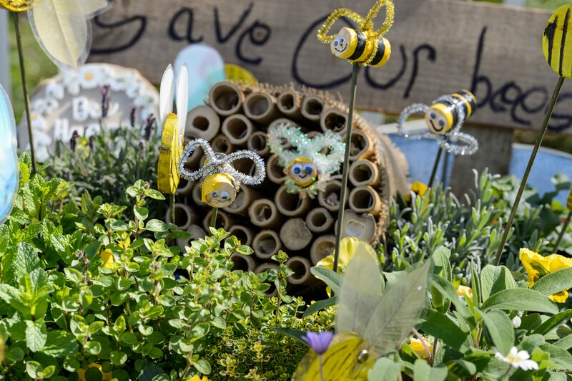







How can we help?
Every school and learner in England we could create:
24,413
9.1 million
Notes:
If every school in England, that’s 24,413 schools, did one small thing such as install plants for pollinators.
We would create thousands of safe homes for insects and animals. Homes for bugs, bees, butterflies, birds, spiders, worms, frogs and more.
If every learner in England, that’s 9.1 million children, did one small thing such as plant a fruit tree.
We would create millions of homes for wildlife, provide food for pollinators and people and help clean the air that we breathe.
Through taking part in the National Education Nature Park, we can create thriving school grounds that can be enjoyed by people, animals, insects and plants. Who knows what we might discover in our school grounds- we could discover a new species!

Slide 9
Let's get started!
Notes:
On this slide, you can insert any specific information about how pupils and staff at your school can get involved. If you are a lead teacher, you could put your contact details down for other staff to contact you to get involved. You could insert information about how pupils could help. This slide could also include information about what the first thing you will be doing or what different year groups will be doing. If you are not sure yet this slide can just be a closing thank you slide 😊
You could also suggest some calls-to-action that pupils (and staff!) could do. For example: at breaktime/on your home or to school see if you can spot an insect, find a leaf and look at all the colours, spend a minute listening to the noises of nature on the playground, when you go back to class tell the person sitting next to you about a plant/animal you’ve seen, explore the playground during breaktime and find an area you like and an area you don’t, talk to another teacher about how you could take part in the Nature park, email another member of staff with this template (insert email template), use the Nature Park taster activity with your class: https://storymaps.arcgis.com/stories/8557212491554e0fb518705925f1a37e

Slide 10
Thank you (insert education setting name)

